Slide 1
BUSINESS INTELLIGENT (BI) SYSTEM FOR GOLDEN GATE RESAURANT CHAIN – MARKETING AND SALES MODULE
[Group 4]
[Meeting type: Kick-Off]
[Date: 01/03/2025]

Slide 2
Meeting Agenda
Kick-Off
Location:
Google Meet
Agenda:
Introduce project team members
Present project scope and objectives
Plan timeline and key milestones
Assign roles and responsibilities
Q&A and address concerns
Participants:
Ho Trung Thanh; Project Sponsor
To Nguyen Tuong Vy; Project Manager
Nguyen Que Anh; Business Analyst
Ngo Thanh Van; QA/QC
Tran Thi Thuy Loi; Data Analyst
Nguyen Huynh Kim Suong, Developer
Key Project Dates:
Kick-Off Date: 03/01/2025
Deployment: 02/27/2025
Project End Date: 11/03/2025

Slide 3
Project Overview
Project Goal:
Centralize and unify data from all brands into a single data warehouse for streamlined analysis, reporting, and decision-making.
Gain insights into customer behavior and feedback to enhance personalized marketing, service quality, and customer satisfaction.
Optimize operational efficiency by tracking KPIs, improving forecasting, managing inventory, and reducing costs.
Measure marketing effectiveness and ensure the BI system is scalable to support Golden Gate’s growth and evolving needs.
Project Description:
A Business Intelligence (BI) system for Golden Gate Restaurant Chain designed to centralize data, gain customer insights, optimize operations, enhance marketing effectiveness, and ensure scalability for long-term growth and adaptability.

Slide 4
Project Overview
Project Budget:
Category | Detail | Description | Estimated Cost ($)
Software and Licensing | BI Tools (Power BI) | Enterprise licenses for centralized BI reporting across all locations. | 0
 | ETL Tool Licensing (Visual Studio 2022) | Data pipeline automation for extracting and transforming data from multiple sources. | 20.000
 | Database License (SQL Server on-premises) | Formatting data | 80.000
Evaluate and collect requirements | Surveys & Questionnaires | Distributing forms to staff and management to understand reporting needs and key KPIs for BI implementation. | 250
 | Process Documentation | Mapping existing workflows, identifying data sources (POS, ERP, CRM), and defining BI integration points. | 300
 | Requirement Validation | Reviewing collected data with stakeholders, refining requirements, and ensuring alignment with business objectives. | 250
 | Competitive Benchmarking | Analyzing BI solutions used by competitors or similar F&B chains to identify best practices and potential improvements. | 300

Slide 5
Project Overview
Project Budget:
Category | Detail | Description | Estimated Cost ($)
Data Integration/ETL (Data Consolidation & Transformation) | Custom Development for ETL Pipelines | Building connectors for integrating POS (Point of Sale) data, customer insights, and operational analytics | 7.000
 | API & Connector Development | APIs to connect BI dashboards with internal CRM, ERP, and marketing databases. | 15.000
 | Data Cleaning & Quality Management | Identifying and rectifying inconsistencies in collected data. | 2.500
Analyze Data | Descriptive Analytics | Generating summary reports on sales, inventory, and operational performance. | 1.500
 | Predictive Analytics | Using data models to forecast trends and optimize restaurant operations. | 2.000
 | Customer Insights Analysis | Analyzing customer behavior and preferences to enhance marketing strategies. | 1.500
Visualization | Dashboard Development | Creating interactive BI dashboards for real-time monitoring. | 5.000
 | Report Customization | Customizing reports for different stakeholders (executives, managers, finance team). | 2.500

Slide 6
Project Overview
Project Budget:
Category | Detail | Description | Estimated Cost ($)
Salary (Labor) | Project Manager (1 person) |  | 600
 | Data Analysts & Engineers (1 person) |  | 400
 | QA/QC Specialist (1 person) |  | 400
 | Product Developer (1 person) |  | 500
 | Business Analyst (1 person) |  | 500
Consulting Services | BI Consulting Fees (External Experts) | BI consultant, customization support and declarative development. | 4.000
User Training | Training Sessions for Employees (120 employees) | In-person or online training to ensure effective use of BI dashboards. | 3.000
 | Training Materials (Documentation, Videos, Guides) | Costs for content creation and distribution. | 1500
Testing | Functional Testing | ensuring all BI dashboards, reports, and integrations work correctly | 1.500
 | Performance Testing | testing query speed and report generation under load | 1.500
 | Security & Compliance Testing | ensuring data security and regulatory compliance | 1.500
 | UAT (User Acceptance Testing) | testing by end-users before final deployment | 1.500

Slide 7
Project Budget:
Project Overview
Category | Detail | Description | Estimated Cost ($)
Implementation Cost | Internet & Network Expenses | Dedicated broadband connections and leased lines for 20locations. | 1.800
 | Electricity & Power Costs | Increased power usage for servers, workstations, and BI dashboards. | 2.200
 | Office Setup & Operational Costs | Temporary workspace arrangements for BI deployment team. | 11.000
Maintenance and Support | System Updates & Patches | Includes ongoing bug fixes, version upgrades, and troubleshooting. | 1.000
 | Backup & Disaster Recovery | Cloud-based or on-prem backup solutions for BI system data security. | 400
Cloud Infrastructure (AWS) | Cloud Storage | Storing transaction data, customer records, and aggregated analytics for 20 locations. | 1.000
 | BI Servers & Compute Instances | Virtual machines to process BI analytics, run queries, and support data visualization. | 4.000
Networking Equipment (Firewalls, Switches, Routers) | Enterprise-Grade Firewalls | Secure data transmission between restaurant locations and cloud servers. | 10.000
 | Redundant VPN Setup for Secure Remote Access | Secure tunneling for remote data access by executives and analysts. | 1.200
 | Total cost |  | 187600

Slide 8
Project Overview
Project Scope:
In scope:
Data integration and infrastructure.
System development and reporting.
Marketing and sales analysis.
User training and support.
Security and compliance.
Out of Scope:
Third-Party campaign execution.
Customer-Facing platforms.
External consulting and maintenance beyond initial setup.

Slide 9
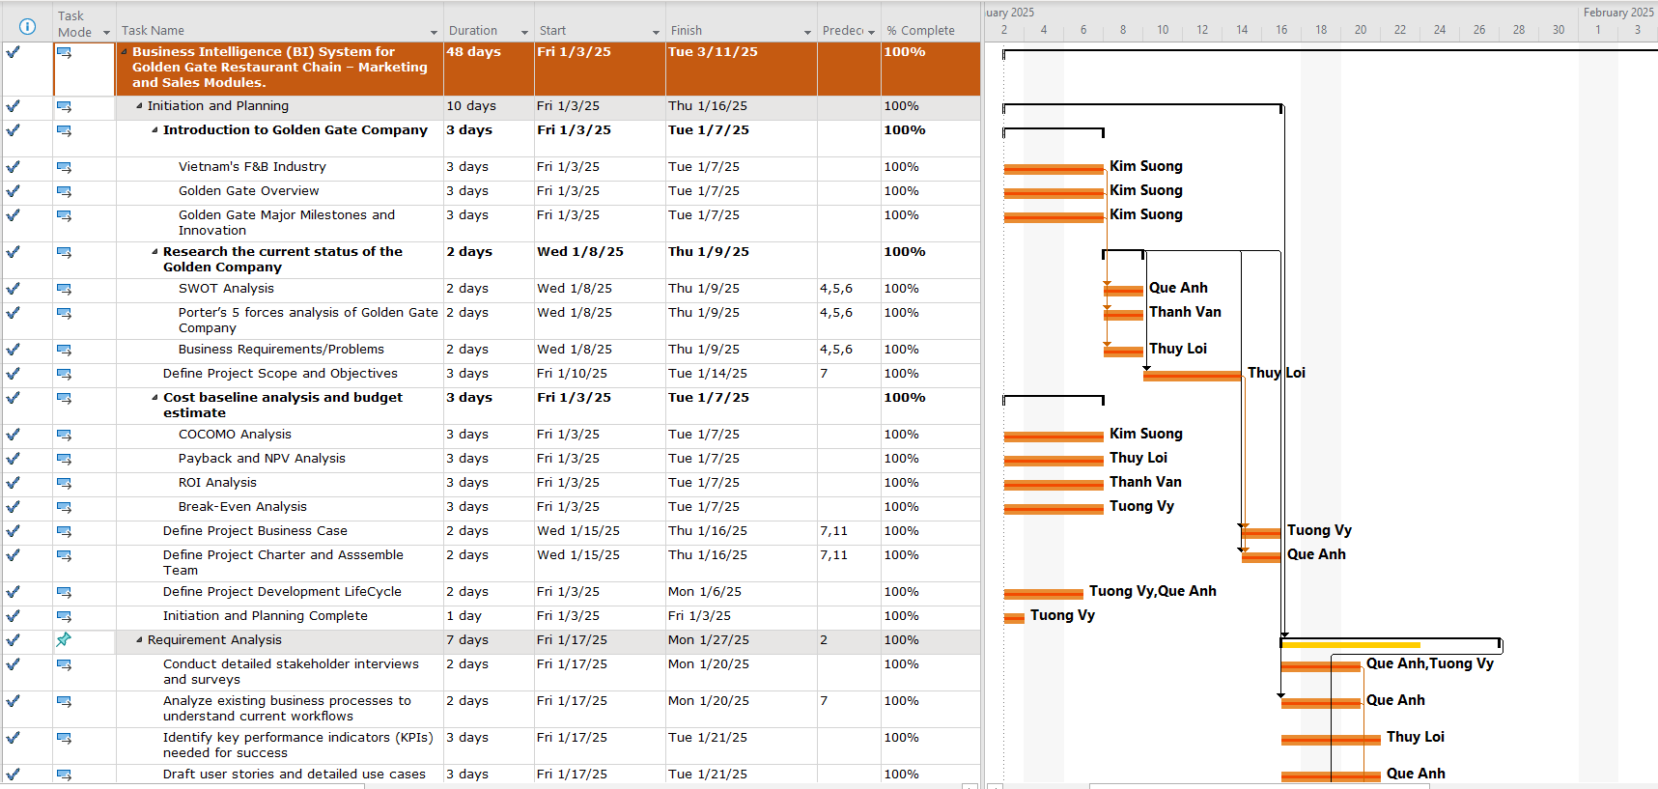
Project Timeline (Gantt Chart)

Slide 10
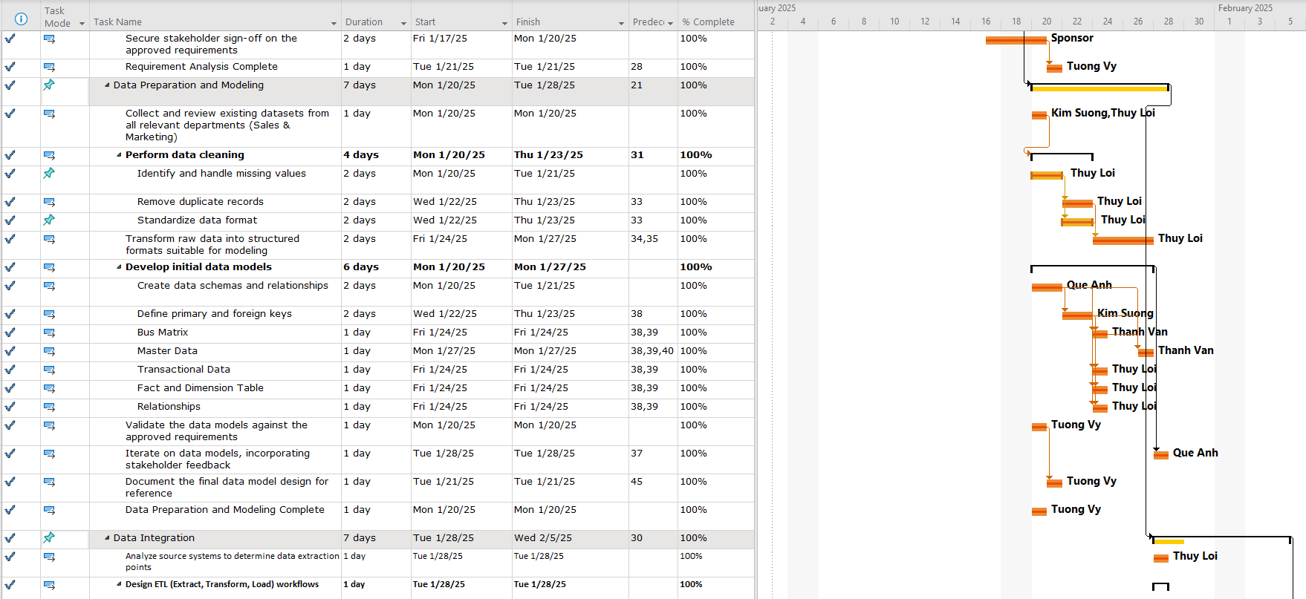
Project Timeline (Gantt Chart)

